Slide 1
An Exploration in Raymarching and Optics By: Paul Grad

Slide 2
Goal
Model physical and optical properties of bubbles and glass
Physical:
Merging and division of bubbles
Optical:
Translucency
Reflection
Refraction/Transmission
Interference patterns
Dispersion
Fresnel Equations

Slide 3

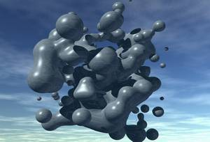
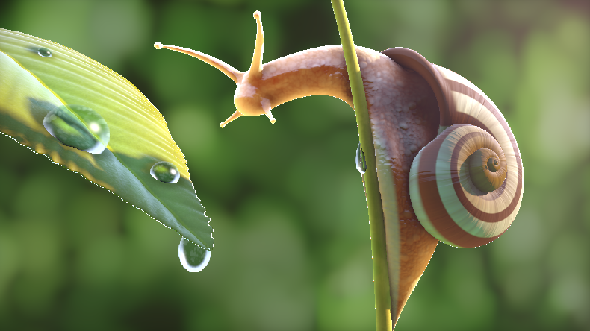
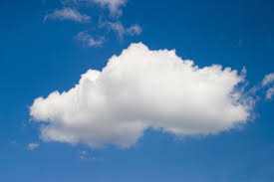
Volumetric Rendering
The computation of 2D images from 3D scalar fields.
Allows for the rendering of objects not as 2D surfaces, but as 3D volumes with depth.
Applications: metaballs, sub-surface scattering of skin, clouds
Multiple implementations: marching cubes, raymarching, splatting

Slide 4
Volumetric Rendering
The computation of 2D images from 3D scalar fields.
Allows for the rendering of objects not as 2D surfaces, but as 3D volumes with depth.
Applications: metaballs, sub-surface scattering of skin, clouds
Multiple implementations: marching cubes, raymarching, splatting

Slide 5
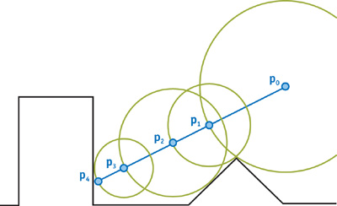
Raymarching by Sphere-Tracing
Problem: If we shoot a ray from a pixel point, what objects does it hit?
Solution: starting from the camera position (ray origin), move the ray the distance to the closest point in the scene. Introduced by Hart.¹
We can’t guarantee a hit, but we know we need to “march” the ray at least that far
¹Sphere tracing: a geometric method for the antialiased ray tracing of implicit surfaces. Visual Computer. 1996

Slide 6
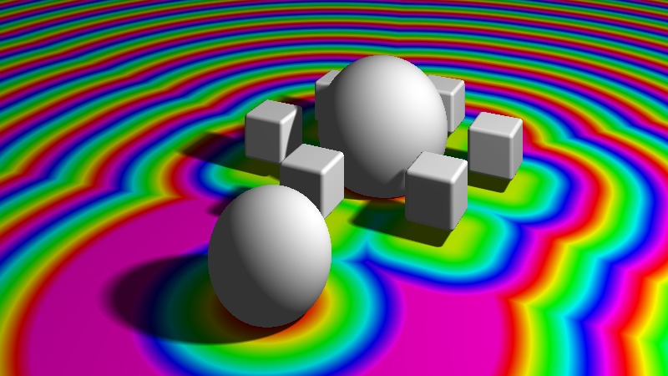
Signed Distance Functions (SDFs)
Scalar Fields? SDFs? Same thing!
Assigning distance from “isosurface” (where distance = 0) to every point in 3D space.
Allows for modeling of geometry that’s difficult to create with meshes.

Slide 7
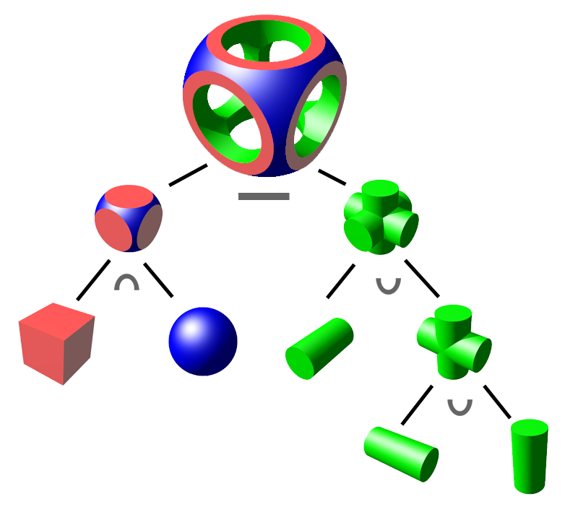
Constructive Solid Geometry
Allows for construction of complex shapes by operating on a set of basic primitives (cubes, spheres, etc.)
Operations: intersection, union, difference

Slide 8
Metaballs
A method for modeling blob-like objects first proposed by Jim Blinn¹.
I use Hart’s distance function described in his paper on sphere-tracing² to model metaballs.
¹A Generalization of Algebraic Surface Drawing. ACM Transactions on Graphics. 1982
²Sphere tracing: a geometric method for the antialiased ray tracing of implicit surfaces. Visual Computer. 1996

Slide 9
Setup in WebGL
Load plane mesh representing the image plane.
Save the camera position, calculated focal length, and window size as uniforms.
Calculate the ray direction to have its xy direction as the uv of the plane, and its z as the focal length.
Calculate the modelview matrix as essentially glu_LookAt with (camera position – origin) as eye and the up vector as vec3(0,1,0).
Multiply the ray direction by the modelview matrix.
Shoot the ray into the scene.

Slide 10
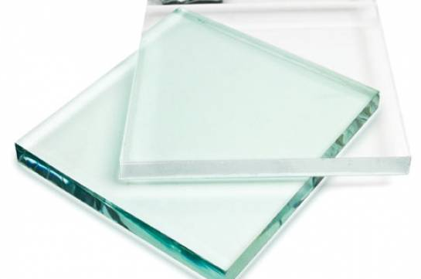
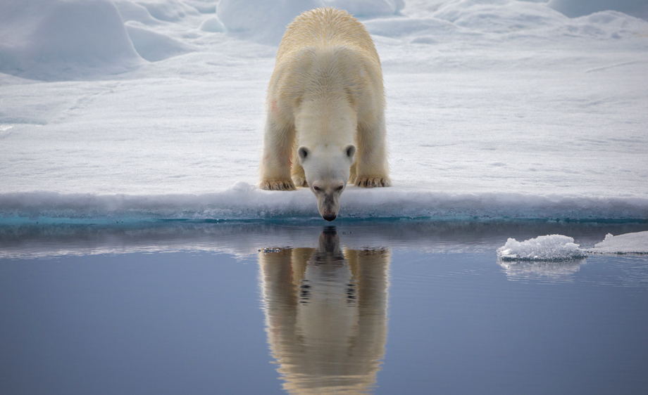
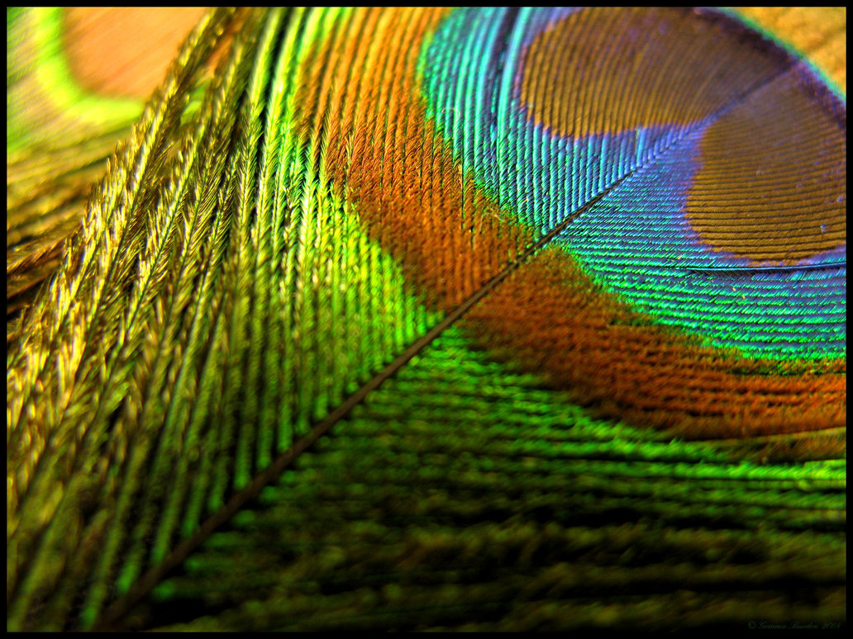
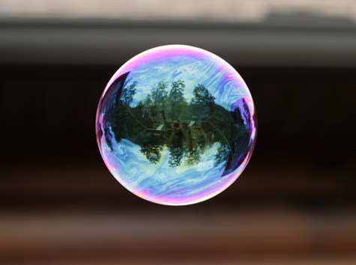
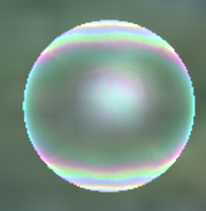
Optical Properties of Bubbles
Translucency
Reflection
Interference

Slide 11
Modeling Translucency
As the ray traversed through each object, I would do post-multiplied alpha blending of the current color with the previous (closer) color.
When the ray reached a distance limit, the color would be mixed with the color from the environment map.

Slide 12
Modeling Reflection
I did two-level recursive ray-tracing.
When the ray hit a point, the ray direction would be reset to the reflection direction reflect(eye, normal).
Ray-marching would then repeat.
Now, instead of doing three-level ray-tracing the environment map was sampled based on the reflection direction.
I also used the Phong illumination model to create highlights.

Slide 13
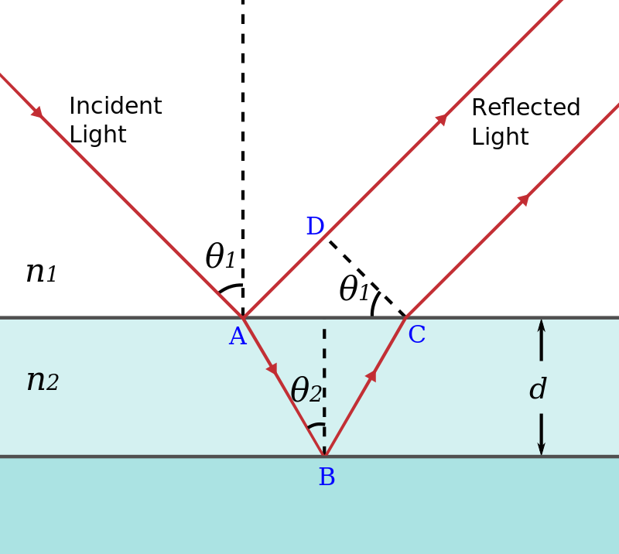
What is Interference?
When waves of the same frequency interact with a phase shift between them, they either constructively or destructively interfere.

Slide 14
What is Interference?
Refraction in the thin film causes a phase shift between the surface reflection and reflection at the bottom of the film.
When reflected off the bottom, a phase shift of 180 degrees occurs.

Slide 15
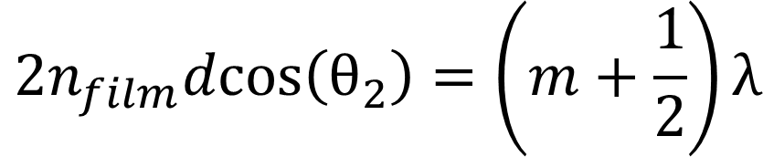
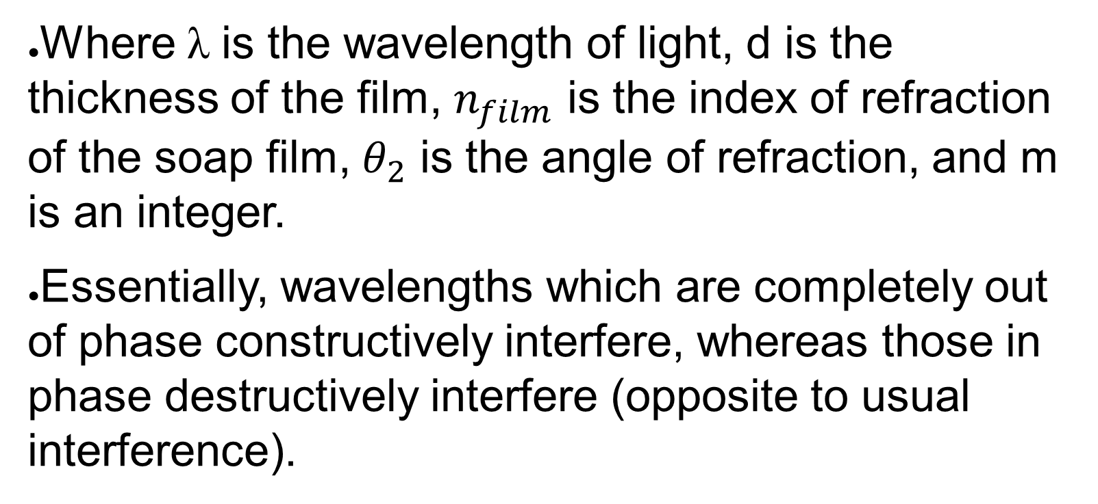
Equation of Thin Film Intereference
The equation governing constructive interference in thin film is thus:
$$2n_{film}dcos\left(θ_{2}\right)=\left(m+\frac{1}{2}\right)λ$$
Where λ is the wavelength of light, d is the thickness of the film, $n_{film}$ is the index of refraction of the soap film, $θ_{2}$ is the angle of refraction, and m is an integer.
Essentially, wavelengths which are completely out of phase constructively interfere, whereas those in phase destructively interfere (opposite to usual interference).

Slide 16
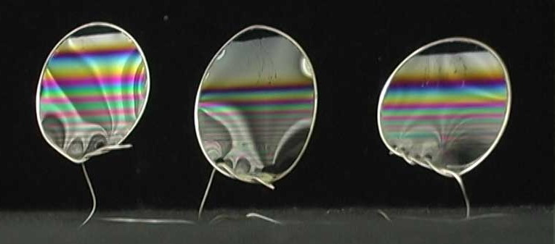
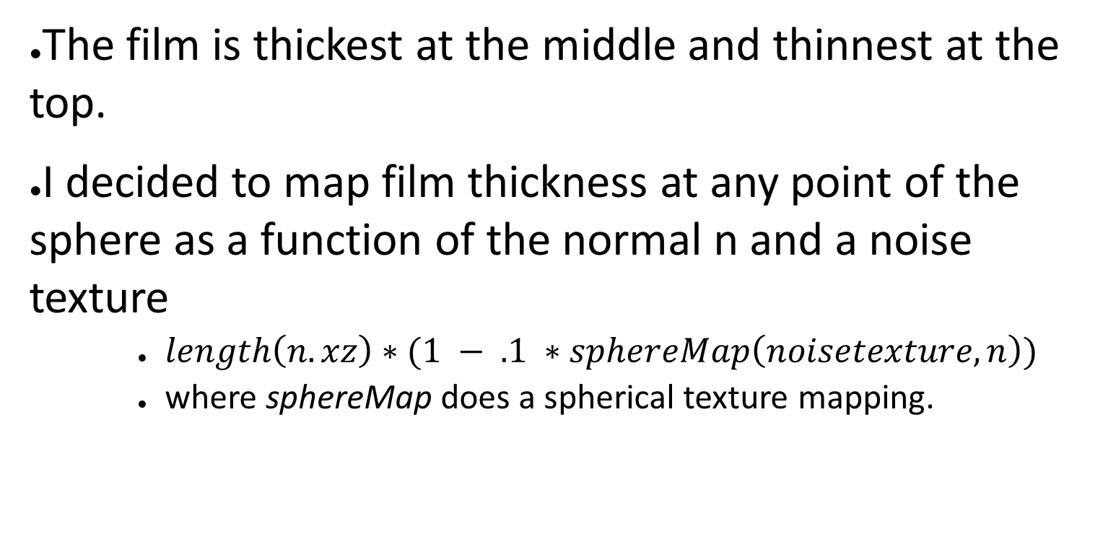
Mapping Film Thickness
The film is thickest at the middle and thinnest at the top.
I decided to map film thickness at any point of the sphere as a function of the normal n and a noise texture
$length\left(n.xz\right)∗(1 − .1 ∗sphereMap\left(noisetexture, n\right))$
where sphereMap does a spherical texture mapping.

Slide 17
Modeling Thin Film Interference
The algorithm:
Calculate the wavelengths that constructively interfere up to 9 iterations of m, using the previous equation.
Map the wavelength into a “rainbow map” and add to the total color from interference.
Add the color from interference to the final color of the object.
The algorithm and its implementation is further described in GPU Gems 3, Chapter 8.

Slide 18
Cue the browser!
Final Result: Bubbles

Slide 19

What is Dispersion?
The refractive index of a material depends on the frequency of light.
Higher frequencies “bend” more than lower frequencies.

Slide 20
Modeling Refraction and Dispersion
3 rays are shot into the scene for each pixel, representing the rgb channels.
The glass has slightly different indices of refraction for each wavelength
The rays diverge from each other, and create multiple overlaid color images in the final 2D image.

Slide 21
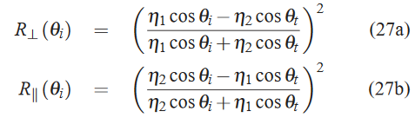

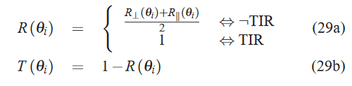
Fresnel Equations
The fresnel term in BRDFs.
Describe the ratio of reflected light vs transmitted light.
At the “critical angle” of incidence, no light is transmitted, only reflected (TIR).

Slide 22
Final Result for Glass
Cue the browser!

